Slide 1
Connecting Online Presence for OSINT and Investigation

Slide 2
Tech Used:
Selenium
BS4
Python
ReactJS
NodeJS
AWS

Slide 3
Idea Used
Web crawlers are built to scrape facebook, Instagram, LinkedIn, TrueCaller, Google Search with latest News
Analysis on the social media data to get close friends data, location data and recent pictures.
Intrusive spam mail functionality has been built to trick the person to disclose his IP and location

Slide 4
Idea Used
AWS ML models are used to compare person’s image with public database.
News obtained about a particular person will tell more about outside activities .

Slide 5
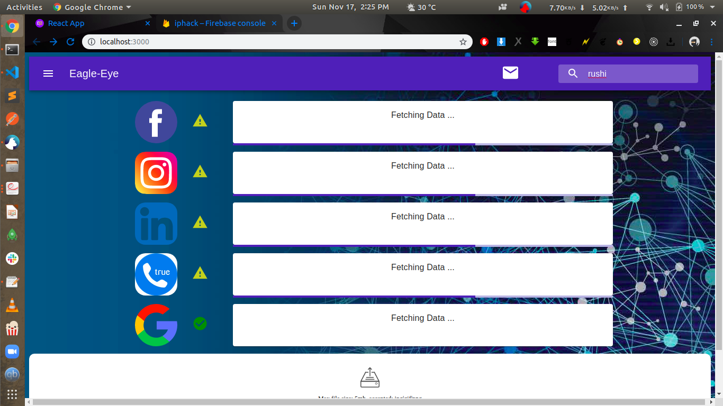

Slide 6
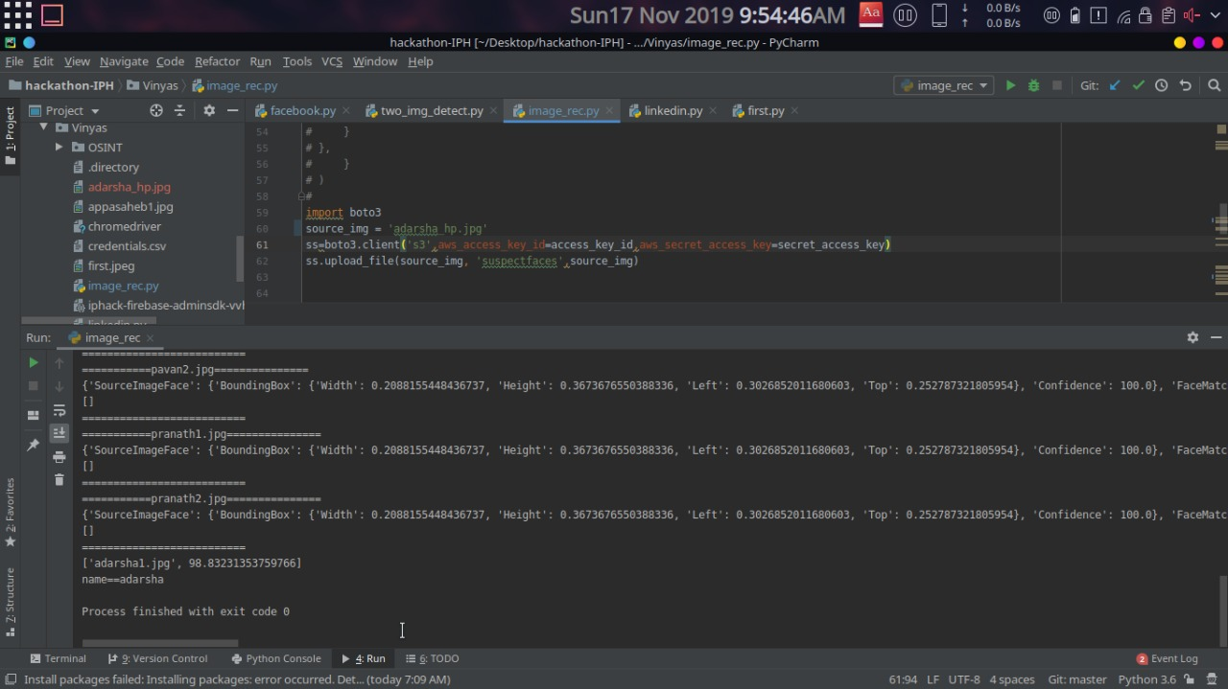

Slide 7
Thank you
BY:
Appasaheb Chavan
K Vinyas Pai
Adarsha H P
Ajay Shastry
Keshava Pranath K

